Slide 1
Landing Page Design
Anis Shili 2021

Slide 2
Archetype
Futuristic
Ambitious
Techie

Slide 3
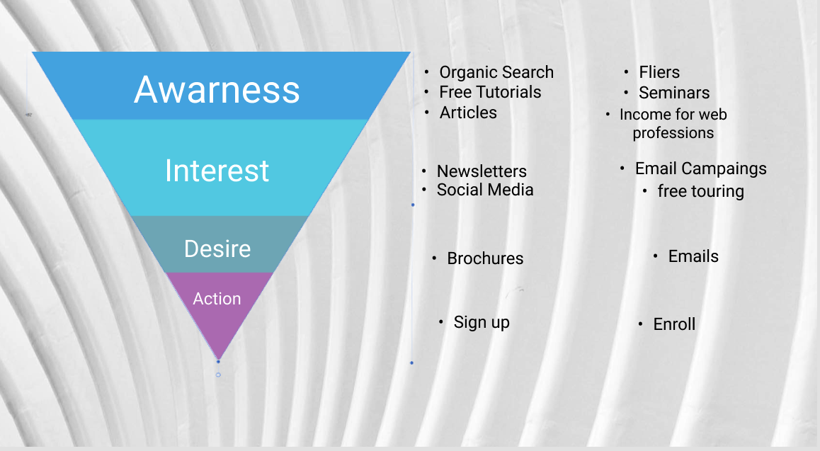
Funnel Strategy
Getting new students

Slide 4

Landing Page
Z Layout

Slide 5
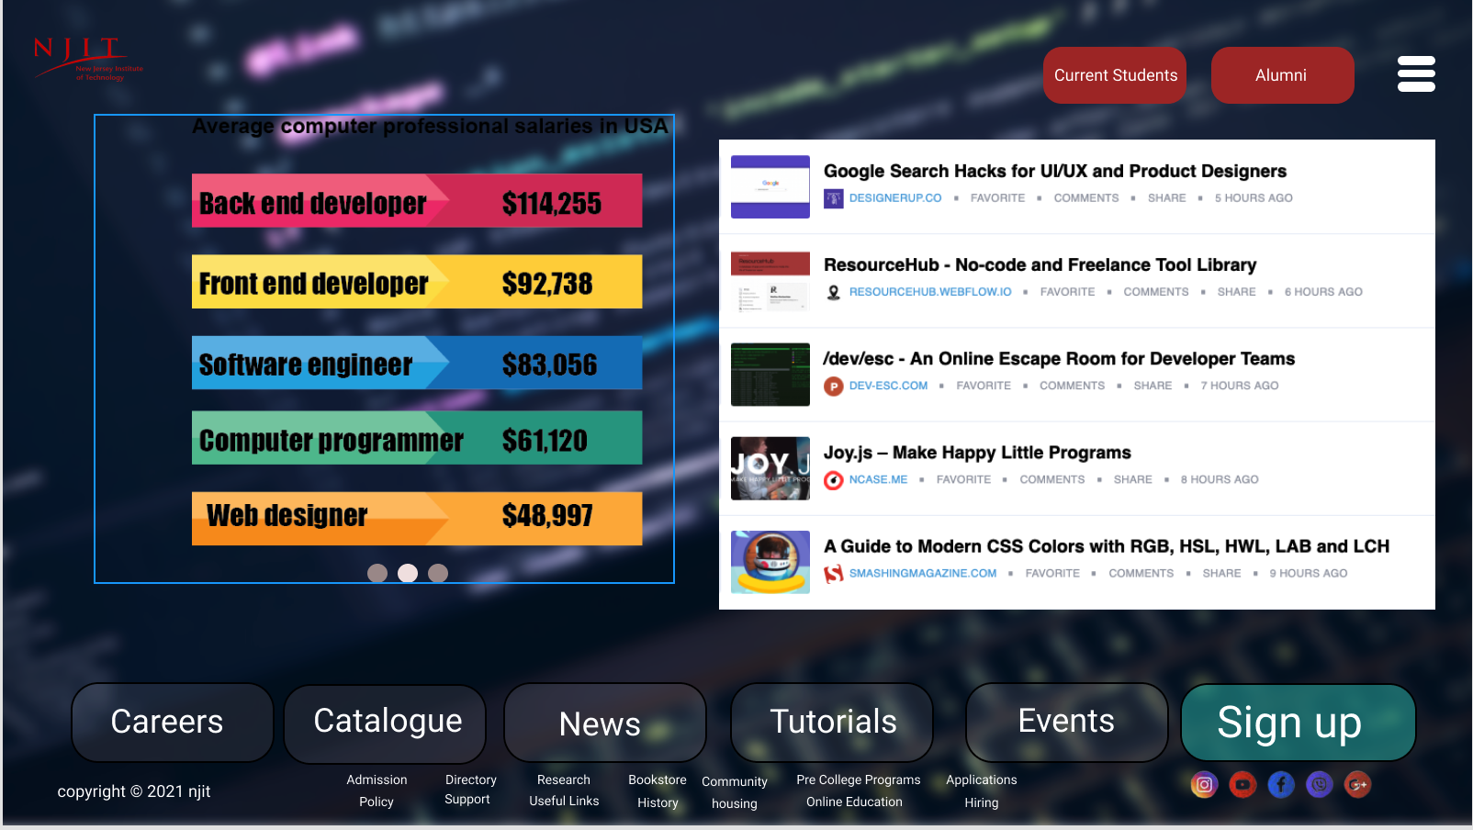
New Students Page

Slide 6
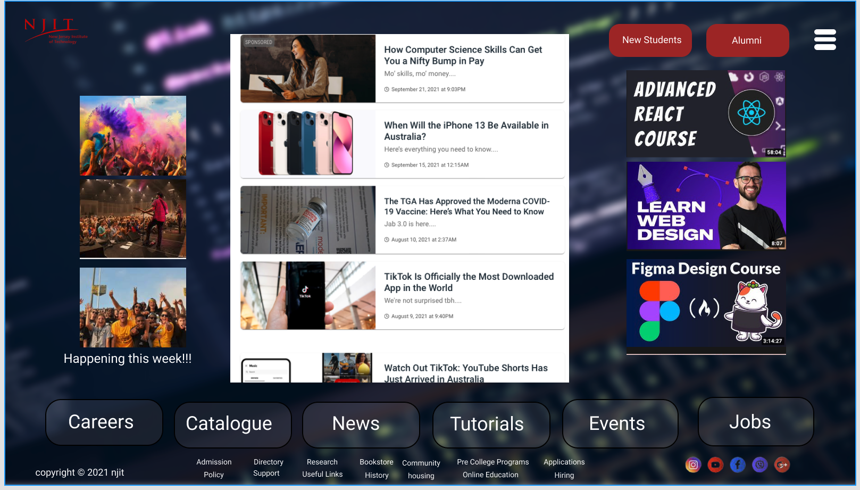
Current Students Page

Slide 7
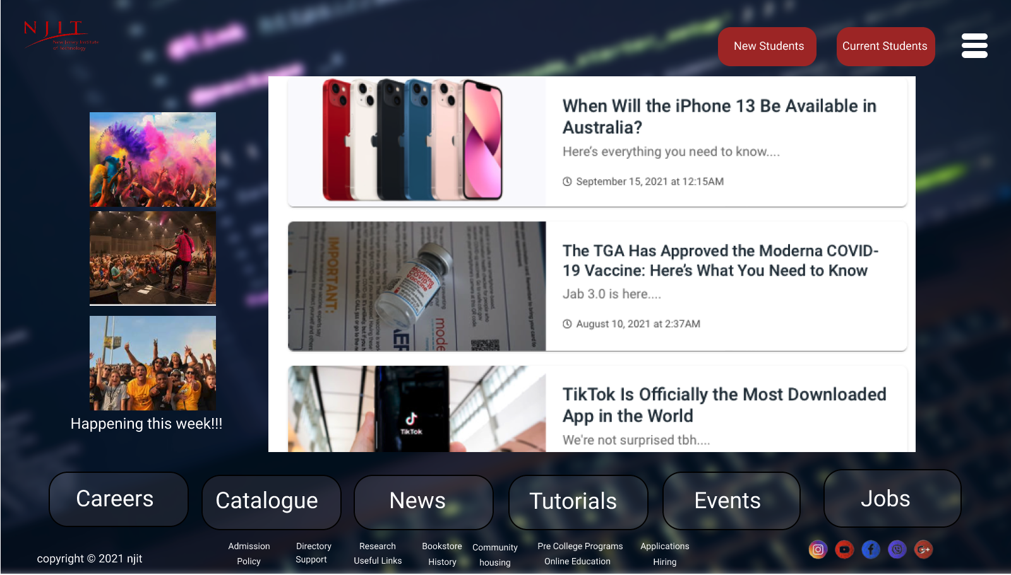
Alumni Page

Slide 8
Prototype

